Slide 1

Organisation & Organisational Structures
MGN-101
UNIT-III
Presented by
P. B. Narendra Kiran - M.B.A., M.Phil., (Ph.D.)

Slide 2


At the end of this lecture, you will be able to-
State the Nature and importance of Organising
Distinguish between the different types of organisational structures
Analyze the formal and informal dimensions of organisations
Explain the centralization and decentralization of authority

Slide 3
Introduction
Organisation : A Social unit of people, systematically structured and managed to meet a need or to pursue collective goals on a continuing basis.
Organisational Structure: All organisations have a management structure the determines the relationships b/w functions and positions, delegates roles, responsibilities and authority to carryout defined tasks.
It is a framework within which an organisation arranges it’s lines of authorities and communications and allocates rights and duties.

Slide 4
Purpose of Organising
Coordinates activities
Cluster job into units
It ensure optimum use of resource
Establish relationship among individual groups
It facilates growth and creativity

Slide 5
Nature / Characteristics of Organisation
❻
❶
Dynamics of
organisation
Group of
People
❷
Chain of
command
Nature of Organisation
Division
of work
❺
Vertical &
horizontal
relationships
Common
purpose
❸
❹

Slide 6
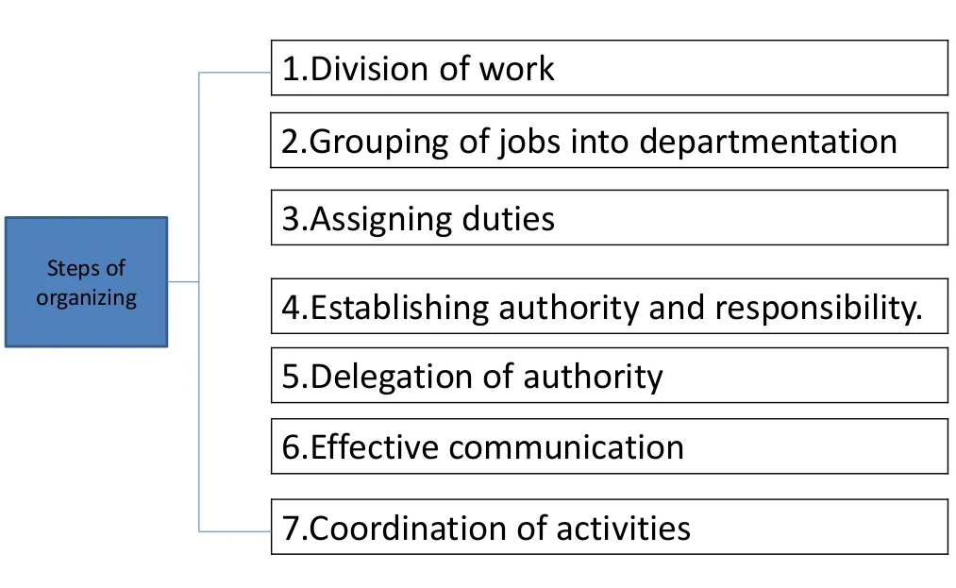
Steps in the process of Organising

Slide 7
Need or Importance of Organization
A tool for achieving objective
Facilitates administration and management
Ensures optimum use of human resource
Enhance creativity
Prevent corruption
Fosters growth of enterprise
Eliminates overlapping and duplication of effort
Coordination

Slide 8

Principles of Organizing
Principle of Objective
Principle of Division of work
Principle of Specialization
Principle of Scalar Chain
Principle of Authority
Principle of Parity of Authority and Responsibility / delegation
Principle of responsibility

Slide 9
………….
Principle of Unity of Command
Principle of Unity of Direction
Principle of Balance
Principle of Simplicity
Principle of efficiency
Principle of Supremacy of Organizational Objectives
Principle of Span of Control

Slide 10
MEANING OF ORGANIZATIONAL STRUCTURE
It defines the scope of acceptable behaviour within an organization
Its lines of authority and accountability
And to some extent organization’s relationship with its external environment
It can be concluded that it shows the pattern or arrangement of jobs and group of jobs within an organization.

Slide 11
Importance of Organisation
Facilitates administration
Facilitates growth and diversification
Permits optimum use of resources
Stimulated creativity
Encourages humanistic approach

Slide 12
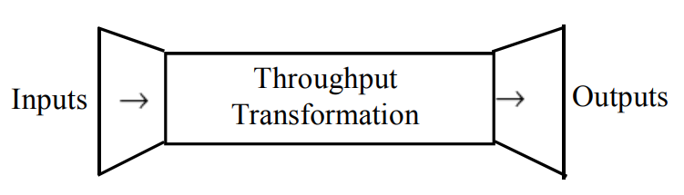
Components of an Organisation System
Inputs
Processor
Output
Management

Slide 13
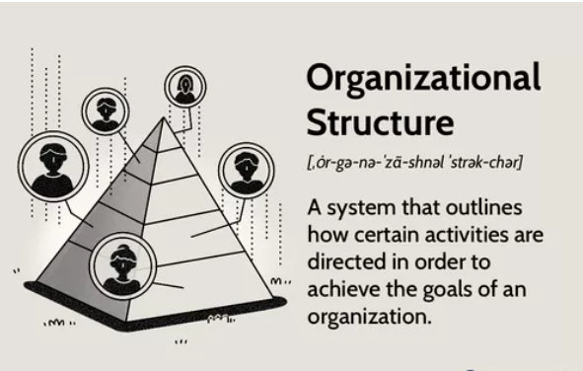
ORGANIZATIONAL STRUCTURE

Slide 14
DEFINITIONS OF ORGANIZATION STRUCTURE
Structure “ is the internal differentiation and patterning of relationships”
- THOMPSON
“ Structure is to be found in an interrelated set of events which return to complete and renew the cycle if activities “
- KATZ and KAHN

Slide 15
Significance of Organisational Structure
Clear – cut authority relationships
Pattern of communication
Location of decision centers
Proper balancing
Stimulating creativity
Encouraging growth
Making use of technological improvements

Slide 16
ORGANIZATIONAL DESIGN
Organization design defines how job tasks are formally divided , grouped and coordinated.
Specifically , there are six key elements that managers need to address when they design an organizational structure.

Slide 17
KEY ELEMENTS OF ORGANIZATION STRUCTURE DESIGN
Work specialization
Departmentalization
Chain of command
Span of control
Centralization and decentralization
Formalization

Slide 18
WORK SPECIALIZATIOM
It describes the degree to which tasks in an organization are divided into separate jobs.
The main idea of this organizational design is that an entire job is not done by one individual. It is broken down into steps, and a different person completes each step.
Individual employees specialize in doing part of an activity rather than the entire activity.
It may also be termed as DIVISION OF LABOUR

Slide 19
DEPARTMENTALIZATION
It is the basis by which jobs are grouped together.
For instance every organization has its own specific way of classifying and grouping work activities.
There are five common forms of departmentalization:
DEPARTMENTALIZATION
FUNCTIONAL PRODUCT GEOGRAPHICAL PROCESS CUSTOMER

Slide 20
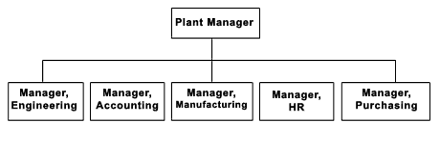
FUNCTIONAL DEPARTMENTALIZATION
It groups jobs by functions performed.
It can be used in all kinds of organizations; it depends on the goals each of them wants to achieve.
For example:-

Slide 21
DIFFERENT ASPECTS OF FUNCTIONAL DEPARTMENTALIZATION
Positive Aspects | Negative Aspects
Efficiencies from putting together similar specialties and people with common skills, knowledge, and orientations Coordination within functional area In-depth specialization | Poor communication across functional areas Limited view of organizational goals

Slide 22
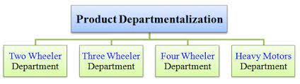
PRODUCT DEPARTMENTALIZATION
It groups jobs by product line. Each manager is responsible of an area within the organization depending of his/her specialization
For example :-

Slide 23
DIFFERENT ASPECTS OF PRODUCT DEPERTMENTALIZATION
Positive Aspects | Negative Aspects
Allows specialization in particular products and services Managers can become experts in their industry Closer to customers | Duplication of functions Limited view of organizational goals

Slide 24
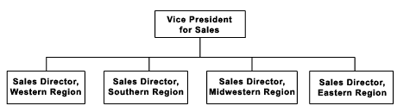
GEOGRAPHICAL DEPARTMENTALIZATION
It groups jobs on the basis of territory or geography.
For example:-

Slide 25
DIFFERENT ASPECTS OF GEOGRAPHICAL DEPARTMENTALIZATION
Positive Aspects | Negative Aspects
More effective and efficient handling of specific regional issues that arise Serve needs of unique geographic markets better | Duplication of functions Can feel isolated from other organizational areas

Slide 26
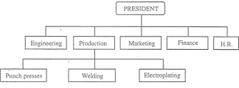
DEPARTMENTALIZATION BY PROCESS
It groups on the basis of product or customer flow.
For example:-

Slide 27
DIFFERENT ASPECTS OF PROCESS DEPARTMENTALIZATION
Positive Aspects | Negative Aspects
More efficient flow of work activities | Can only be used with certain types of products

Slide 28
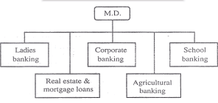
CUSTOMER DEPARTMENTALIZATION
It groups jobs on the basis of common customers.
For example:-

Slide 29
DIFFERENT ASPECTS OF PROCESS DEPARTMENTALIZATION
Positive Aspects | Negative Aspects
Customers' needs and problems can be met by specialists | Duplication of functions Limited view of organizational goals

Slide 30
CHAIN OF COMMAND
It is defined as a continuous line of authority that extends from upper organizational levels to the lowest levels and clarifies who reports to whom.
There are three important concepts attached to this theory:
Authority: Refers to the rights inherent in a managerial position to tell people what to do and to expect them to do it.
Responsibility: The obligation to perform any assigned duties.
Unity of command: The management principle that each person should report to only one manager.

Slide 31
SPAN OF CONTROL
It is important to a large degree because it determines the number of levels and managers an organization has.
Also, determines the number of employees a manager can efficiently and effectively manage.

Slide 32
CENTRALIZATION AND DECENTRALIZATION
More Centralization | More Decentralization
Environment is stable Lower-level managers are not as capable or experienced at making decisions as upper-level managers. Lower-level managers do not want to have say in decisions Decisions are significant. Organization is facing a crisis or the risk of company failure. Company is large. Effective implementation of company strategies depends on managers retaining say over what happens. | Environment is complex, uncertain. Lower-level managers are capable and experienced at making decisions. Lower-level managers want a voice in decisions. Decisions are relatively minor. Corporate culture is open to allowing managers to have a say in what happens. Company is geographically dispersed. Effective implementation of company strategies depends on managers having involvement and flexibility to make decisions

Slide 33
FORMALIZATION
It refers to the degree to which jobs within the organization are standardized and the extent to which employee behavior is guided by rules and procedures.
HIGH LEVELS | LOW LEVELS
minimum amount of discretion over what, when, and how consistent output explicit job descriptions organizational rules clearly defined procedures | Unprogrammed behaviors exercise discretion great deal of freedom less standardization consider alternatives

Slide 34
Different forms of
Organisational Structures
Line Organisation
Line and Staff Organisation
Functional Organisation
Project Organisation
Matrix Organisation
Network Organisational Structure
Committee Organisation

Slide 35
1. Line Organisation
It is the oldest and simplest form of organisational structure
Also known as military, vertical, departmental and hierarchical organisation structure
In line organisation, authority flows from the top to bottom vertically in a straight line manner
Responsibility and accountability flows in an opposite but equally direct vertical manner
Line organisation may be of 2 types –
Pure line organisation
Department line organisaton

Slide 36
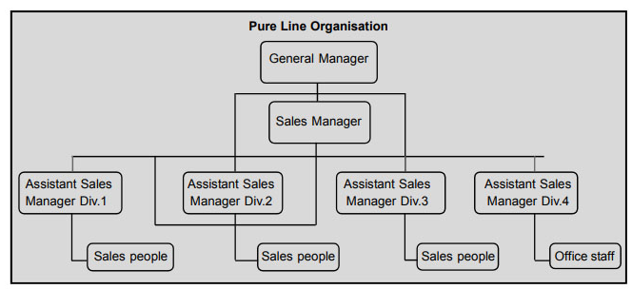
1(a). Pure Line Organisation
Pure line organisation is one in which activities at a particular level are the same.
Every employee at the same level performs by and large the same type of work.
Departments are created for the sake of convenience to the supervisor.

Slide 37
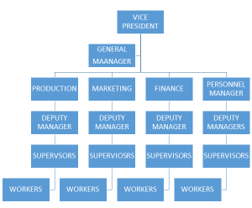
1(b). Department Line Organisation
Here whole work of the organisation is divided into functional departments like HR, Finance, Production, Marketing, etc.,
Each department works as a self sufficient unit under the supervision of a departmental manager.

Slide 38
Suitability of line organisation
This structure is suitable for the following types of business organisations:
Small scale or sole proprietary organisaiton
Organisations with simple routine operations
Organisations having automatic and continuous production function
Organisations having short chain of command
Organisations having a few subordinates at each level

Slide 39
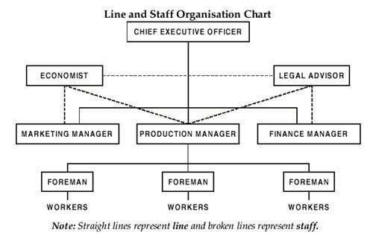
Line & Staff Organisation

Slide 40
2. Line & Staff Organisation
It is a modification over the basic line structure
This structure combines the staff specialists / experts with the line managers
The vertical flow of authority and responsibility remain the same as in line structure
Additionally, staff specialists are associated with line managers
Staff specialists / experts are the persons / departments who provide technical advice or service to the line managers
Line managers may / may not use their specialized knowledge.

Slide 41
2. Line & Staff Organisation
In line and staff organization, decisions are made by specialists and experts of related field.
Therefore, decision making is effective in this type of organization structure.
Because of better coordination, specialization and proper division of work, there is balanced work load and less burden to the line executives.
This type of organization is also called as scalar organization.

Slide 42
Suitability of Line & Staff Organisation
It is most suitable for medium and large organisations
This structure is not suitable for small organisations on account of high cost involved in it.

Slide 43
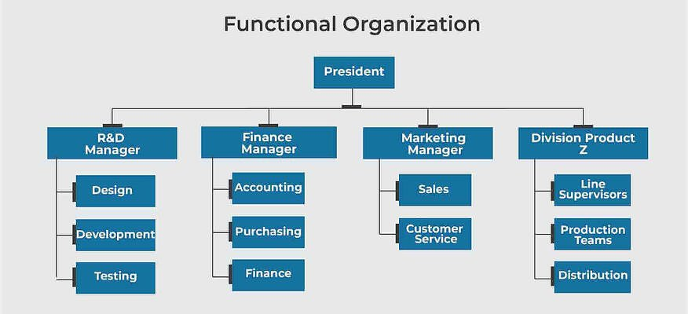
3. Functional Organisation

Slide 44
3. Functional Organisation
This structure is based on the concept of functional foremanship
In this structure, the line authority is channelized through the staff specialists
Line authority runs through many functional experts who have the authority to issue orders in their areas of specialization
For every department (Finance, HR, Marketing, Production…) their exist an expert who has direct control over that department.
Thus there is multiplicity of command instead of unity of command.

Slide 45
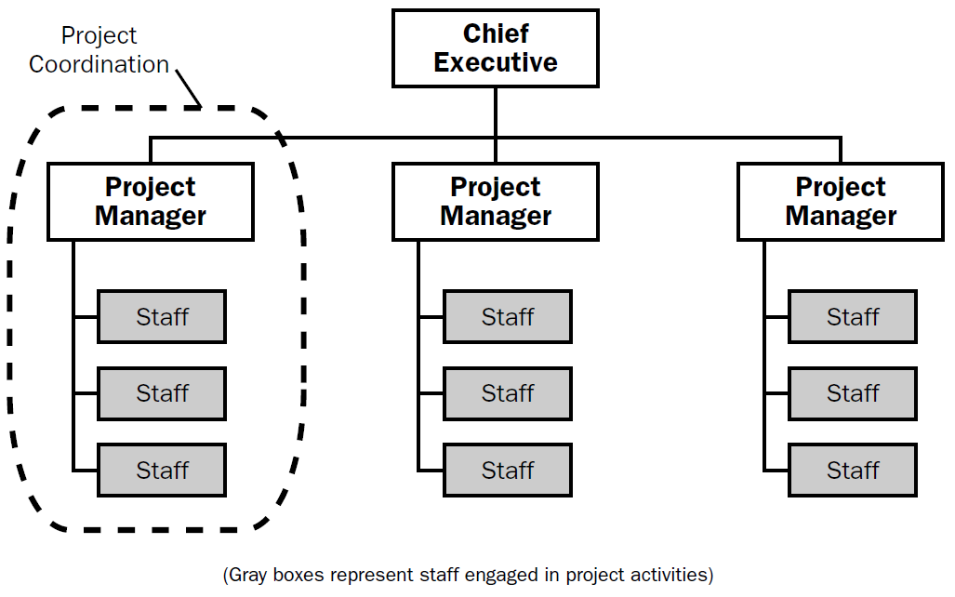
4. Project Organisation

Slide 46
4. Project Organisation
It is a temporary structure designed to accomplish a specific task or project with the help of specialists drawn from different functional departments within the organisation.
It is lead by a project manager
He draws specialists from different functional department and assigns them activities necessary to accomplish the project
Project manager is responsible for the coordination of all the personnel working on the project.

Slide 47
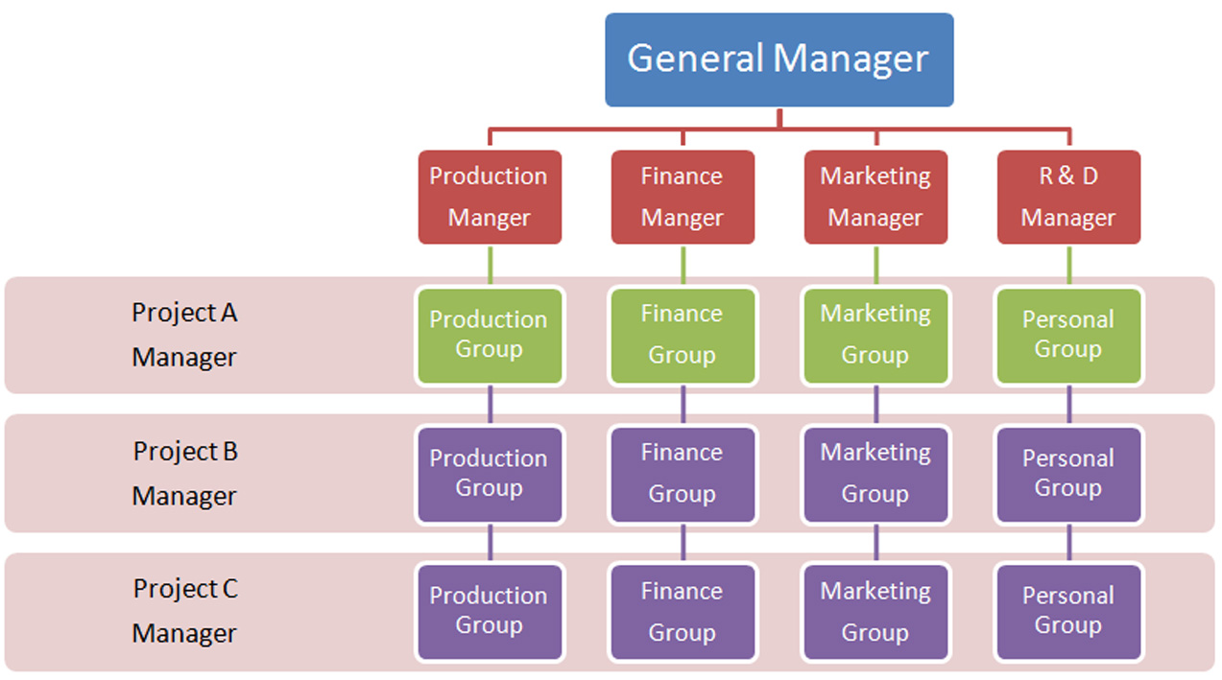
5. Matrix / Grid Organisation

Slide 48
5. Matrix / Grid Organisation
It is a hybrid organisation structure
It combines project organisation structure and functional organisational structure
It is a permanent organisaiton structure designed to accomplish a specific project by using team of specialists drawn from different functional departments within an organisation
There are functional managers and project managers
Team members are accountable to both functional managers and project mangers

Slide 49
Suitability
Suitable for complex tasks
Suitable for projects with specified time and cost
Suitable for aerospace, construction, advertising, hospital which have specified time and cost framework

Slide 50
6. Network Organisational Structure
A network structure is the one in which more than one organization combine to produce a good or provide a service.
These organizations can either get into a partnership for a particular venture, or one organization can hire others to handle one or more of its functions (outsourcing), for example, marketing, production, sales and so on.
Outsourcing is done by organizations pursuing network structure.

Slide 51
6. Network Organisational Structure
The NETWORK ORGANIZATIONAL STRUCTURE (also called virtual network structure)
It is a temporary or permanent arrangement of otherwise independent organizations or associates, forming an alliance to produce a product or service by sharing costs and core competencies.
The network-based organizational structure Opens in new window is built around alliances between organizations within the network.
Each associate or organization of the network focuses on its core competency and performs some portion of the activities necessary to deliver the products and services of the network as a whole.

Slide 52
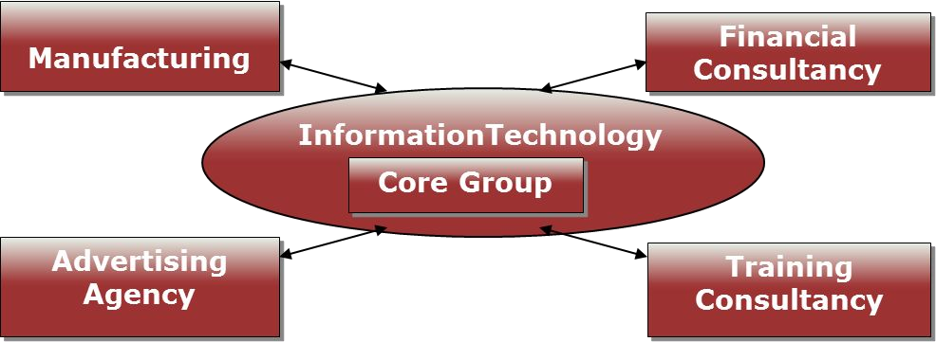
6. Network Organisational Structure

Slide 53
7. Committee Organisation
It is a form of staff organization formed for giving specialized advice to line managers.
A committee is a group of two or more appointed, nominated or elected persons to consider, discuss, decide, recommend or report on some issue or matter assigned to them.
Types of committees:
On the basis of duration
a) Permanent committees
b) Ad hoc committees
On the basis of purpose
a) Advisory committee
b) Executive committee

Slide 54
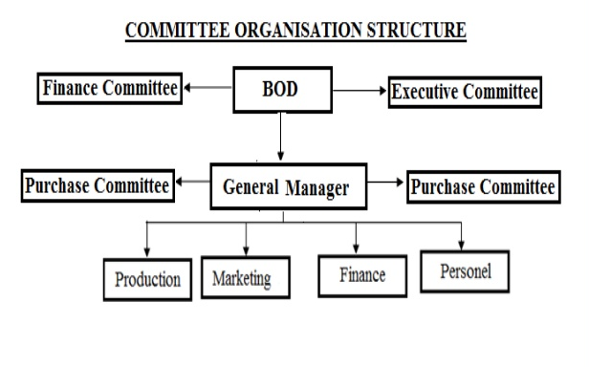
7. Committee Organisation

Slide 55
THANK YOU

